Slide 1
FollowBot Android Application
Arian Stolwijk – 4001079
Radu Florea - 4330358

Slide 2
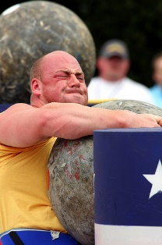

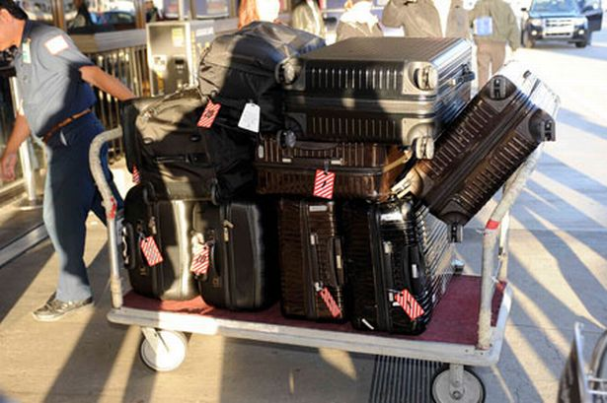
Motivation
People carry things everyday and everywhere
E.g.: airport luggage, groceries, military equipment etc.
What if a robot can do it for us?

Slide 3
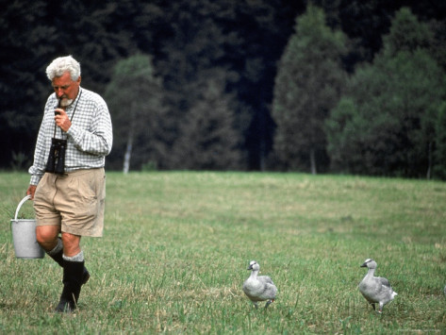
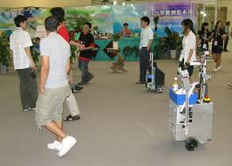
Suggested Solution
Inspired by biological behavior
Human-following robot
Low-cost equipment
Only an Android smartphone and an interface board required

Slide 4
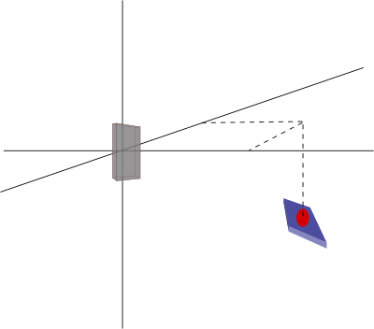
How can it be done?
Initial estimate of the robot’s position and orientation
Use colored, spherical shaped markers to track the robot
Detect markers using thresholding and Hough transform
Use simple algebra and geometry to obtain the transformation matrix

Slide 5
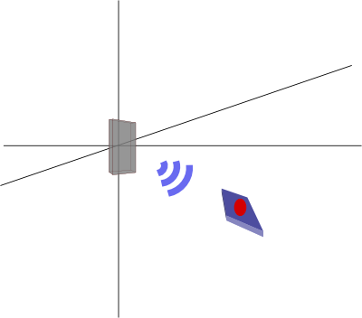
How can it be done?
User’s activity monitored using the accelerometer data
K-NN classifier used to differentiate between standing, walking or running
Obtain a new estimate of the robot’s position using a particle filter
Estimations based on Bluetooth RSSI (Received Signal Strength Indicator) and phone orientation

Slide 6
Thank you for your attention!

